Slide 1
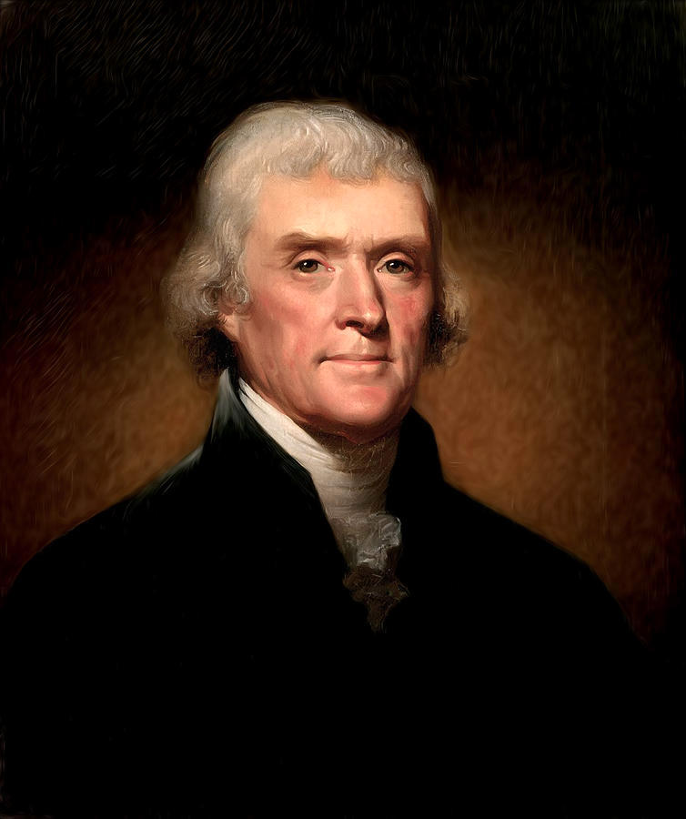
They Call Him… TJ
The Jefferson Presidency

Slide 2
Targets

Slide 3
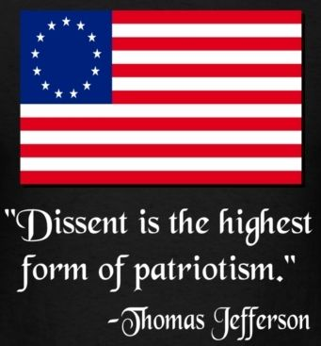
Personal Philosophies
Goal: Peaceful transfer of power between parties
Dream: Reunite two parties through “liberal democratic philosophy”
Goal: Majority rule, minority rights
Dream: Plato’s rule of “Philosopher Kings”→ appointed upper-class, highly educated men
Goal: Laissez-Faire in federal government
Style: down-to-earth, simple, didn’t want to seem elitist
Practice: Moderate, doesn’t vary much from Hamilton

Slide 4
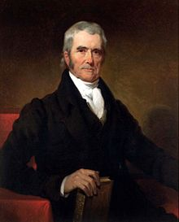
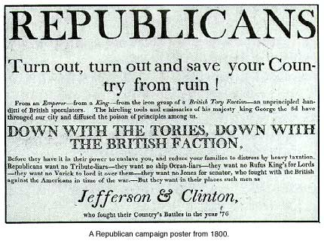
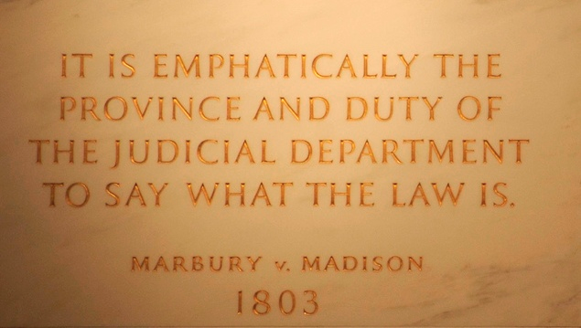
Presidency
1801 – Revoked Alien & Sedition Acts→ naturalization to 5yrs.
Repealed Judiciary Act→ “Midnight Judges” lost positions→ Marbury v. Madison (1803)
Impeached corrupt federal judges
Tried to retire public debt ($83M in 16yrs)
Cut bureaucracy, defense
Grew state militias & est. West Point

Slide 5
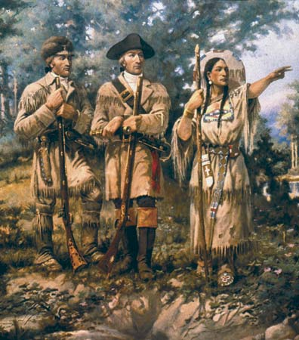
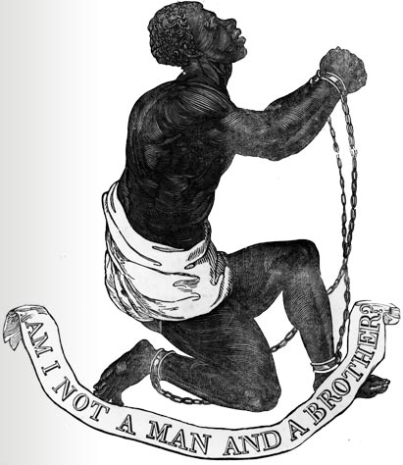
Did NOT address racial divide
Indian lands not protected in westward expansion
Importation of slaves ends (1808) but still smuggled in
Constructed National Road (1806)→ stretched congressional power→ mindset change
X
Lewis,
Clark,
Sacajawea

Slide 6
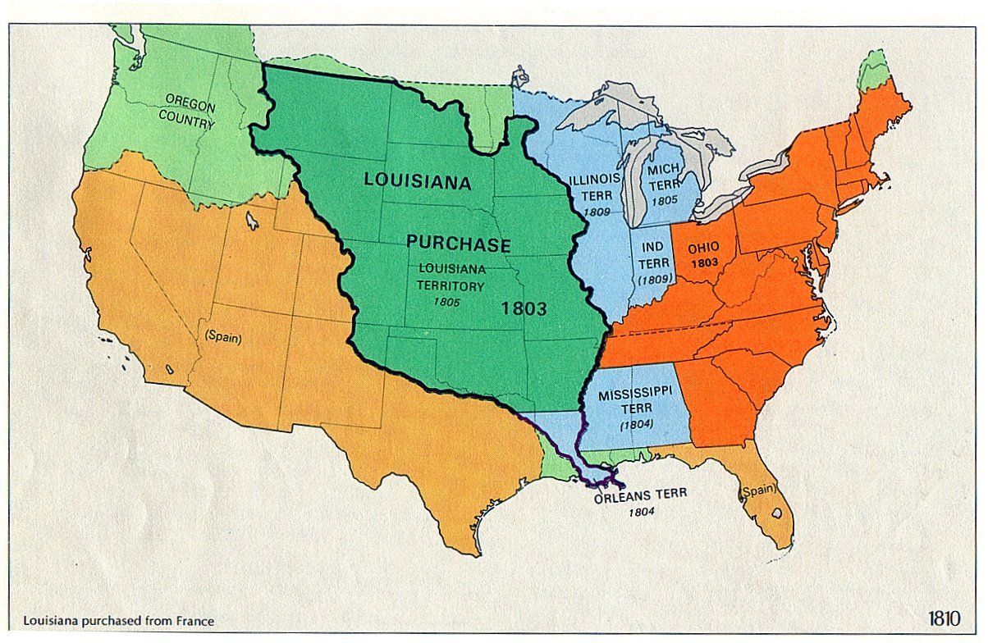
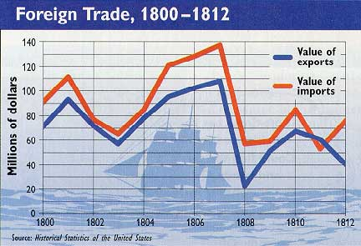
Louisiana Purchase (1803)
Napoleon gets LA from ESP in 1800
Sent Livingstone to Paris to buy N.O. & FLA, Tallyrand offered ALL of LA b/c FRA didn’t want to defend & needed $ now
$15M & promise of Catholic freedom
Embargo Act (1807) – Forbade all US exports→ lifted in 1809

